Slide 1
Making this resource work for you
Prior to teaching this lesson, please refer to the ‘Unit Overview and Planning Document’.
Further guidance on planning Science Mastery lessons can be found in the detailed planning guidance document.
Refer to the ‘notes’ section on each slide for useful information, including suggested expositions, pedagogical content knowledge, suggested questions, answers and more. Consider using presenter mode so you can see this guidance throughout the lesson.
The introduction slides can be adapted to suit your teaching style and the needs of your class.
Before the lesson, adapt the fix-it slide to address any misconceptions identified in the previous lesson’s exit ticket.
Choose from the suggested activities to suit your class. The intention is not that you complete all of these, but that you select those which ones are most appropriate for your students. It may be appropriate to further adapt activities for your students.
These lessons are designed to occupy approximately 1 hour. To adapt for a shorter or longer lesson duration we advise you to adapt the activity section accordingly.
Please consider using the final slide to send feedback about this lesson or examples of PowerPoints that you have adapted to our design team. Your feedback is used to improve Science Mastery for all of our teachers and students. We appreciate all suggestions and comments.
Thank you for reading!
The Science Mastery Team

Slide 2

Recycling Metals
Answer the questions below.
State a use of copper metal.
State one disadvantage of traditional mining of metal ores.
Name one metal that does not need to be extracted from an ore.
Glass is made from limited raw materials. Name one thing that people can do to reduce the amount of raw materials we use for glass products.
(HT) Define bioleaching.
Copper metal is used for electrical wiring.
Traditional mining of metal ores destroys habitats.
Gold, silver
People can reduce their use of glass, reuse glass products or recycle glass.
Bioleaching is a method to extract metals from their ore using living organisms such as bacteria.
Notes:
Big idea: Reactions Rearrange Matter
Foundation: What method of extraction could be used to obtain pure lithium from an ore? (Choose from electrolysis or displacement reaction with carbon?)
Stretch: Explain why this method would be chosen instead of the other.
Answers:
Foundation: Electrolysis
Stretch: Lithium is more reactive than carbon. Therefore, a lithium ore would not react with carbon, and the lithium could not be extracted this way.

Slide 3
Recycling Metals
Do Now:
State a use of copper metal.
State one disadvantage of traditional mining of metal ores.
Name one metal that does not need to be extracted from an ore
Glass is made from limited raw materials. Name one thing that people can do to reduce the amount of raw materials we use for glass products
(HT) Define bioleaching.
Drill:
Copper oxide is an ore of copper with the formula CuO. Calculate the relative formula mass of copper oxide.
Calculate the percentage composition of oxygen in CuO.
Notes:
Answers:
Do Now:
1. Copper metal is used for electrical wiring
2. Traditional mining of metal ores destroys habitats
3. Gold, silver
4. People can reduce their use of glass, reuse glass products or recycle glass.
5. Bioleaching is a method to extract metals from their ore using living organisms such as bacteria.
Drill:
79.5
% composition = mass of oxygen/RFM of CuO x 100. 16/79.5 x 100 = 20.1%

Slide 4
Recycling Metals
Read Now:
A new battery recycling service in Portsmouth has been a massive success. 750 kg of batteries were collected by the City Council’s battery recycling service in just the first 2 months of the service running. The types of batteries that can be recycled include regular household batteries, laptop batteries, and batteries from hearing aids. After collection, the batteries are sorted so that as much material as possible can be recovered to make new products. Batteries contain toxic metals such as mercury and lead which can do great harm to the environment and the health of organisms. By recycling, these materials can be used in new products, and they don’t end up in landfill.
What does this new service in Portsmouth do?
What mass of batteries was collected in the first 2 months?
What kinds of batteries are collected by this new service?
Why is it important to recycle old batteries?
Define the word in bold.
Notes:
Answers:
This new service recycles old batteries
750 kg of batteries was collected in the first 2 months
Regular household batteries, laptop batteries and batteries from hearing aids
If old batteries are not recycled, they will end up in landfill where they can damage the environment and the health of organisms.
Recycling – converting waste materials into new products

Slide 5

C4.2.15
22/11/2024
Recycling Metals
C4.2.1 PKR: Reactions of Metals
C4.2.2 Extracting Less Reactive Metals
C4.2.3 PKR: Ions, Ionic Bonding and Deducing Ionic Formulae
C4.2.4 (HT) Ionic Equations and Displacement Reactions
C4.2.5 (HT) Writing Half Equations
C4.2.6 (HT) Ionic Equations for the Reactions of Acids and Metals
C4.2.7 Introduction to Electrolysis
C4.2.8 Extracting Metals by Electrolysis
C4.2.9 Electrolysis of Molten Ionic Compounds
C4.2.10 Electrolysis in Solutions
C4.2.11 RP: Electrolysis of Aqueous Solutions 1
C4.1.12 RP: Electrolysis of Aqueous Solutions 2
C4.1.13 TIF: Corrosion and its Prevention
C4.2.14 (HT) Obtaining Raw Materials
C4.2.15 Recycling Metals
C4.2.16 Feedback Lesson
Notes:
Big Idea: Reactions Rearrange Matter
Suggested Hook: Ask for a show of hands from students. How many of them recycle? Discuss: What do they recycle? Why?

Slide 6

Following this lesson, students will be able to:
Describe how metals are recycled
Describe the ethical, social, economic and environmental impacts of recycling metals
Suggest how the public and businesses might be encouraged to recycle their waste metals
Key Words:
recycle
ethical
social
economic
Notes:
Guidance:
See unit overview document and planning guidance to see how these objectives are typically assessed at GCSE, including examples of what students should be able to do following this lesson.
Planning for different needs:
The learning objectives given on this slide are suggested based on the most common requirements for exams, however they can be adapted based on the needs of different classes.
For best practice, the unit preparation booklet should be used to determine the appropriate focus of lessons within the unit.
While it is not possible to explicitly split content into levelled grades, we recommend that lesson objectives can be classified as critical, core or stretch.
Critical: the content or skill is essential for all students to be able to progress.
Core: the content or skill is important for students to progress, but other opportunities may be available to revisit it.
Stretch: the content or skill may not be essential for all students but is important for students aiming for the highest grades.
Key skill: this is a crucial skill being developed in this unit as part of the skill mapping
C4.2.15 Lesson Objectives:
Critical: Describe how metals are recycled
Core: Describe the ethical, social, economic and environmental impacts of recycling metals
Stretch: Suggest how the public and businesses might be encouraged to recycle their waste metals

Slide 7
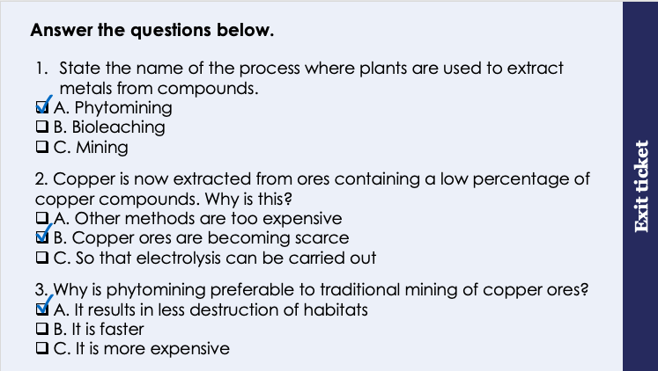
This is the fix-it portion of the lesson
The fix-it is an opportunity to respond to gaps in knowledge, especially those identified by the previous lesson’s exit ticket.
The teacher should customise this slide as needed, to facilitate
reteach, explanation, demonstration or modelling of ideas and concepts that students have not yet grasped or have misunderstood.
practise answering specific questions or of key skills.
redrafting or improving previous work.
Notes:
Purpose: to spend time on any gaps identified in previous learning from exit ticket feedback.
Fix-it guidance from previous exit ticket:
Q1. Answer: A
If students answer B or C, they are unable to define the methods of extracting metals from ores. To fix-it, ask students to review their notes and then to define each term.
Q2. Answer: B
If students answer A or C, they do not understand why alternative methods of extraction are needed. To fix-it, show students the graphs on slides 8 and 9 of this powerpoint and ask them to explain what they tell us.
Q3. Answer: A
If students answer B or C, they are unable to describe a disadvantage of traditional mining. To fix-it, ask students to create a table that compares traditional mining with phytomining, including any environmental effects.

Slide 8
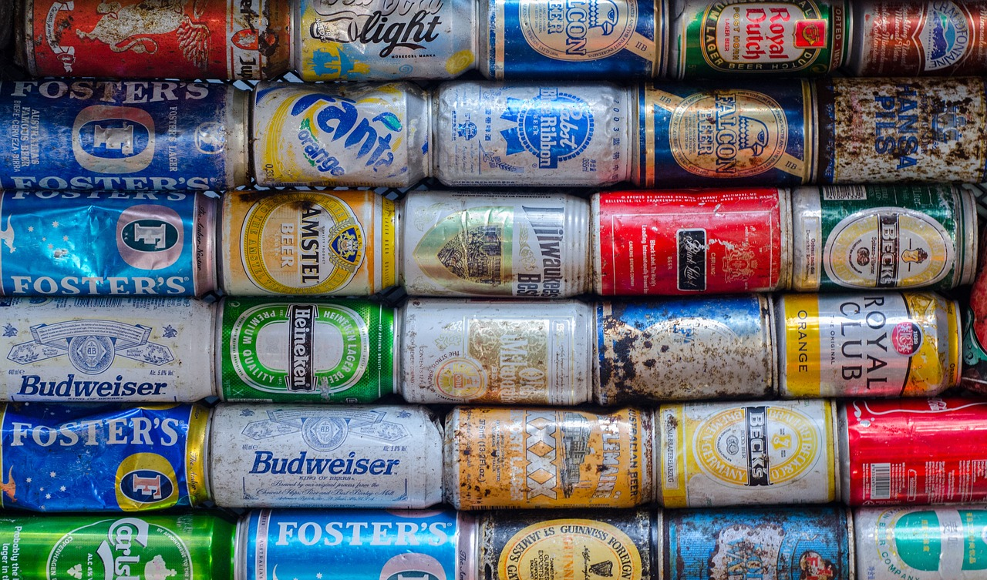
Recycling Metals
Recycling metals involves collecting used metal items and turning them into new metal items
To do this:
Scrap metal is collected and transported to a sorting centre
Items are broken up, and sorted into different kinds of metals
Other materials such as plastic are removed
The metals are melted down
The metals are recast into new items
Notes:
Exposition type: Explanation
Model teacher exposition:
In year 9 we discussed the recycling of plastics. Today we will be focusing on the recycling of metals.
What is meant by recycling of metals? Recycling of metals involves collecting used metal items and turning them into new metal items.
Hands up if anyone in this room has recycled metal items in the past. Maybe you have recycled drink cans, or batteries.
Usually, there is a local place you can go to to do this.
Get google maps up on the screen to look for local recycling centres with students. Check if they recycle metals and what metal items they accept.
If the school facilitates any metal recycling (for example drink cans bins) highlight this for students.
So what happens to the metal we recycle once we take it to these recycling centres?
There are a few things that happen.
First, the metal has to be transported to a sorting centre.
Here the items are broken up into different types of metal and sorted. For example the aluminium from a drink can would be sorted separately from the lead in a battery – because these will be used for different things later.
If there are any other materials mixed in like plastic or rubber, then these are removed and they might be recycled separately.
The metals are then melted down into liquids.
Finally, the metals are recast – that means made into new items.
Take the 5 steps off the screen and challenge students to remember these steps without the slide.

Slide 9
The effects of recycling metals
Advantage
Disadvantage
Category | Effect
Social (an effect to do with people)
Environmental (an effect to do with the environment)
Economic (an effect to do with money)
People have to make the effort to sort and recycle their metal waste.
The recycling of metals provides jobs for people.
Less damage to the environment as no quarries or mines are required.
Less noise pollution from heavy traffic.
Valuable raw materials are preserved.
Sorting and recycling metals costs a lot of money
It costs less to recycle metals than it does to extract new metals from ores.
Notes:
Model teacher exposition:
In year 9 we discussed the advantages and disadvantages of recycling plastic. Today we will do the same but for metals.
When discussing effects of recycling, we can categorise the advantages and disadvantages into social, environmental and economic effects.
What do you think a social effect is? Something that effects people.
As you might already know, in order to recycle people have to make the effort! So that is a social effect. They might need to drive to a recycling centre or separate metal items from their other waste at home. This can be an inconvenience.
But on a positive note, lots of people are employed at recycling centres, so that is a positive social effect.
What do you think an environmental effect is? Something that effects the environment.
There are three main positive environmental effects of reycling metals.
When we recycle, we no longer have to obtain metals from ores, so we no longer need to blast huge holes in the ground to obtain the ores. So there is far less damage to the environment/habitats. We also don’t have lots of metal waste ending up in landfill which is another way it causes less damage to the environment. The quarries often have many many heavy trucks driving in and out all day to transport the ores, so we don’t have those when we recycle more metals. Finally, we are preserving valuable metal ores so they can stay in the ground.
What do you think an economic effect is? Something that has to do with money/the economy
It actually costs a lots of money to recycle metals. You need to pay for the people who are employed to do the work, all of the materials needed, the transport to bring the metal to the sorting centre, the energy needed to melt the metals down. So this is a disadvantage. However, it is far more expensive to extract new metals from their ores. Remember, this often involved electrolysis which needs a lot of energy!
You will need to be able to discuss the advantages and disadvantages of recycling metals, and to classify these as social, environmental and economic effects of recycling.

Slide 10
Recycling Metals
Many metals can be recycled.
Describe the advantages and disadvantages of recycling metals.
Social disadvantage:
People have to make the effort to sort and recycle their metal waste.
Social advantage:
The recycling of metals provides jobs for people.
Environmental advantages:
Less damage to the environment as no quarries or mines are required.
Less noise pollution from heavy traffic from quarries
Valuable raw materials are preserved.
Economic disadvantage:
Sorting and recycling metals costs a lot of money
Economic advantage:
It costs less to recycle metals than it does to extract new metals from ores.
Notes:
Purpose: The I-We-You section aims to support pupils to build skills that they most commonly need when answering questions associated with this knowledge in the assessment. This section is also used to interleave other content we expect pupils to know at this stage of their education in order that they build a big picture of the science they are learning.
For the ‘I’ activity, the teacher should model how to answer the question. They can do this by narrating their thinking process aloud, and making links to learning earlier in the lesson explicit.
For the ‘we’ activity, the teacher and students work though a similar example together, in order to prepare students to be able to answer a similar question independently.
Opportunities for the ‘you’ activity – independent practise – occur in the activity portion of the lesson once the student is secure enough to process independently.

Slide 11

Imagine you work for the local council
Discuss: What could you do to convince more people and businesses to recycle metals?
Notes:
Suggested guidance:
Talk tasks can be used in a variety of ways to suit the particular needs of the students you are teaching. Through exchanging views with others, students develop their understanding of the science beyond what could be achieved individually.
Science classrooms that successfully integrate talk have the following features:
Science talk is a regular feature of lessons and is woven into classroom activities.
Students are paired or grouped strategically by the teacher to ensure productive interaction. This might take into consideration the students’ proficiency of the English language, how encouraging they might be to peers and their attainment in the topic. It’s a good idea to consider these pairings in the class seating plan.
Students are encouraged and supported to talk, but are not forced to talk.
The teacher should take on the role of a facilitator, engaging with conversations where necessary and encouraging or steering the conversation where needed.
Students are encouraged to use the language they have to express their ideas (e.g., everyday language, imperfect English, native language), but also to incorporate science specific terminology where this is more accurate or has been taught.
6. Scientifically inaccurate ideas are not dismissed by the partner or teacher; open discussion and further investigation are relied on to help students construct ideas that support them to progress in their scientific understanding.
7. Guidelines for behaviour during talk tasks are explicit and frequently reviewed. Rules for students might be:
Listen carefully to your partner
Take turns talking.
Speak one at a time, without interrupting.
Politely agree or disagree and explain why.
Politely point out if your partner has used a scientific word incorrectly, if they have explained the science incorrectly, or if there is a more accurate way to describe something.
If confused, ask questions.
Stay focused on the discussion topic.
Respond to one another.

Slide 12
Drill
What does recycling metals involve?
What does it mean to recast a molten metal?
Describe a social advantage of recycling metals.
Describe a social disadvantage of recycling metals.
Describe an environmental advantage of recycling metals.
Describe an economic advantage of recycling metals.
Describe an economic disadvantage of recycling metals.
Notes:
Purpose: This is a knowledge drill. The purpose of this is to check that the critical knowledge is secure before pupils move onto independent practice.
Suggested guidance: There are a range of ways this could be done depending on time and ability range of the class:
Mini whiteboards
As full sentences in exercise books
As short answers in exercise books
In the pupil workbook
As pair talk
As cold call

Slide 13
Drill answers
Recycling metals involves collecting used metal items and turning them into new metal items
Recasting a metal means shaping a molten metal to make a new product
A social advantage of recycling metals is that it provides jobs
A social disadvantage of recycling metals is that people have to make the effort to sort and recycle their metal waste.
An environmental advantage of recycling metals is that valuable raw materials are preserved.
An economic advantage of recycling metals is that it costs less than extracting metals from ores
An economic disadvantage of recycling metals is that it costs a lot of money.
Notes:
Purpose: This is a knowledge drill. The purpose of this is to check that the critical knowledge is secure before pupils move onto independent practice.
Suggested guidance: There are a range of ways this could be done depending on time and ability range of the class:
Mini whiteboards
As full sentences in exercise books
As short answers in exercise books
In the pupil workbook
As pair talk
As cold call

Slide 14

I: Explain: to use scientific understanding to make something clear or state the reason for something happening
Example question:
To ‘explain’ your answer should:
Begin with a scientific statement.
Use ‘this means that’, ‘because’ or ‘so’ to link your statement to the question.
Copper ores are becoming harder and harder to find. One solution to meet the demand for copper is to recycle copper items.
Explain why copper should be recycled.
Model answer:
Copper should be recycled to preserve valuable natural resources (ores)
and because recycling is less expensive than extracting metal from its ore
Notes:
This slide models the process of answering an explain question.
Firstly, students are presented with a generic explain question, along with a model answer. Students are also given some simple guidance to follow for producing their own describe answer.
The generic question and answer should be used by the teacher to remind students of
the key features of a great answer
how to structure their answer
why the model answer is a good example
Following this, students will be required to apply this process to answer their own explain question, which will appear in place of the generic questions. This explain question will be specific to the topic students are learning about in the lesson. Give students time to write their own answer to this, ensuring that they use the guidance provided. To further scaffold this task for students, it may be appropriate to:
pair students up to write an answer together
list for students the key words you would like them to include in the answer
provide a writing frame or ‘points to include’ for students
A model answer for this question will appear. Teachers should review the model answer with students by referencing the guidance in the green box. For example ‘we can see item 1 in the guidance is to begin with a scientific statement. Notice in the model answer here we have done just that’. Or ‘item 2 in the guidance here says that we should use a linking statement in the answer. Has this been achieved in the model answer? Where can we see this?’.

Slide 15
We: Explain: to use scientific understanding to make something clear or state the reason for something happening
Example question:
To ‘explain’ your answer should:
Begin with a scientific statement.
Use ‘this means that’, ‘because’ or ‘so’ to link your statement to the question.
Aluminium metal is used to make drinks cans. It is obtained from ores within the Earth’s crust by electrolysis. Aluminium cans can be recycled.
Explain why aluminium should be recycled.
Model answer:
Aluminium cans should be recycled to preserve valuable natural resources (ores)
and because recycling these cans is less expensive than extracting metal from its ore
Notes:
This slide models the process of answering an explain question.
Firstly, students are presented with a generic explain question, along with a model answer. Students are also given some simple guidance to follow for producing their own describe answer.
The generic question and answer should be used by the teacher to remind students of
the key features of a great answer
how to structure their answer
why the model answer is a good example
Following this, students will be required to apply this process to answer their own explain question, which will appear in place of the generic questions. This explain question will be specific to the topic students are learning about in the lesson. Give students time to write their own answer to this, ensuring that they use the guidance provided. To further scaffold this task for students, it may be appropriate to:
pair students up to write an answer together
list for students the key words you would like them to include in the answer
provide a writing frame or ‘points to include’ for students
A model answer for this question will appear. Teachers should review the model answer with students by referencing the guidance in the green box. For example ‘we can see item 1 in the guidance is to begin with a scientific statement. Notice in the model answer here we have done just that’. Or ‘item 2 in the guidance here says that we should use a linking statement in the answer. Has this been achieved in the model answer? Where can we see this?’.

Slide 16
You: Explain: to use scientific understanding to make something clear or state the reason for something happening
Example question:
To ‘explain’ your answer should:
Begin with a scientific statement.
Use ‘this means that’, ‘because’ or ‘so’ to link your statement to the question.
Many metals can be recycled but are not always.
Explain why people may not always recycle metals.
Model answer:
people might not be aware of the advantages of recycling
people might not be provided with facilities, bins or areas to recycle their old copper items
people might not know that items are recyclable
Notes:
This slide models the process of answering an explain question.
Firstly, students are presented with a generic explain question, along with a model answer. Students are also given some simple guidance to follow for producing their own describe answer.
The generic question and answer should be used by the teacher to remind students of
the key features of a great answer
how to structure their answer
why the model answer is a good example
Following this, students will be required to apply this process to answer their own explain question, which will appear in place of the generic questions. This explain question will be specific to the topic students are learning about in the lesson. Give students time to write their own answer to this, ensuring that they use the guidance provided. To further scaffold this task for students, it may be appropriate to:
pair students up to write an answer together
list for students the key words you would like them to include in the answer
provide a writing frame or ‘points to include’ for students
A model answer for this question will appear. Teachers should review the model answer with students by referencing the guidance in the green box. For example ‘we can see item 1 in the guidance is to begin with a scientific statement. Notice in the model answer here we have done just that’. Or ‘item 2 in the guidance here says that we should use a linking statement in the answer. Has this been achieved in the model answer? Where can we see this?’.

Slide 17
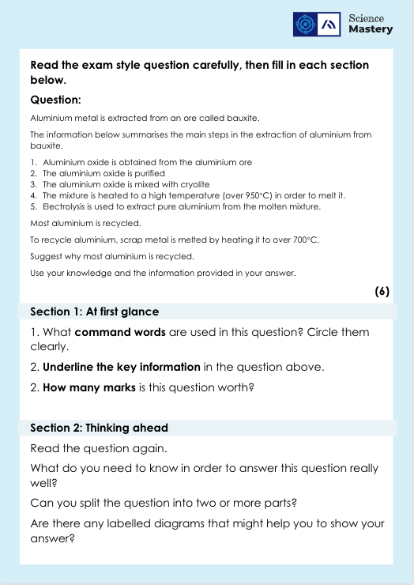
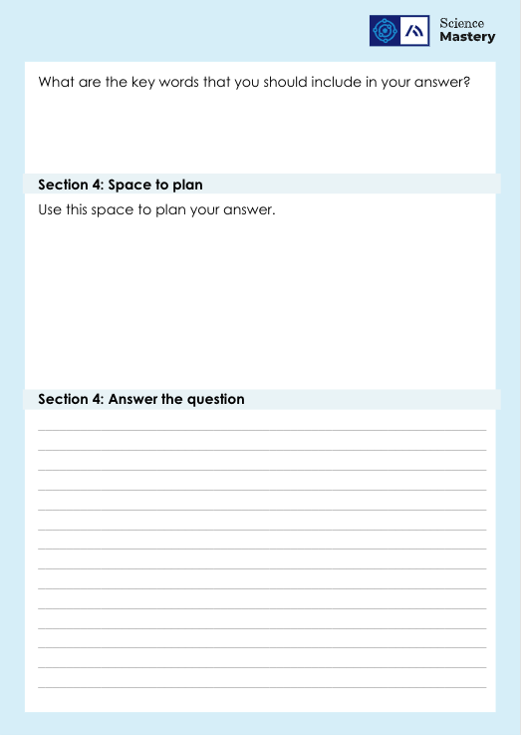
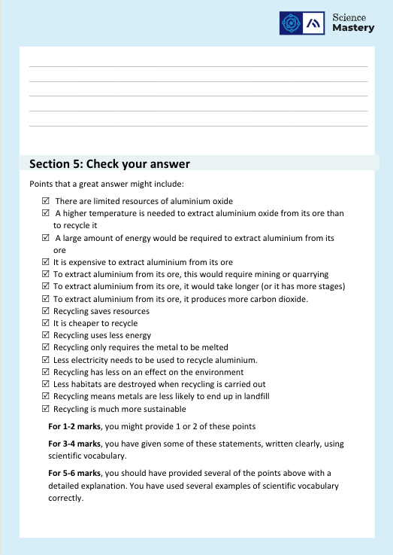
Exam Question Activity

Slide 18
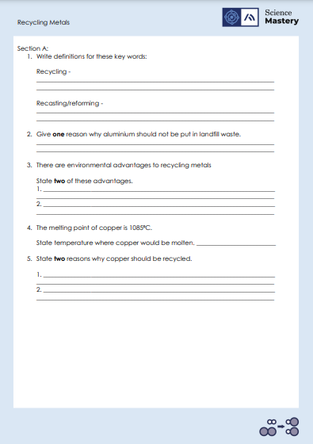
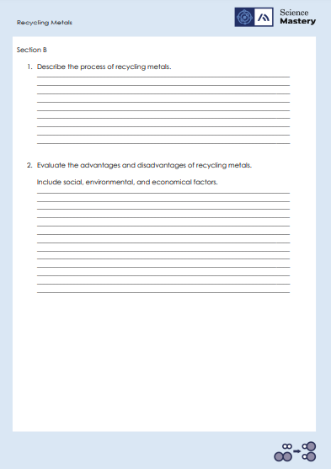
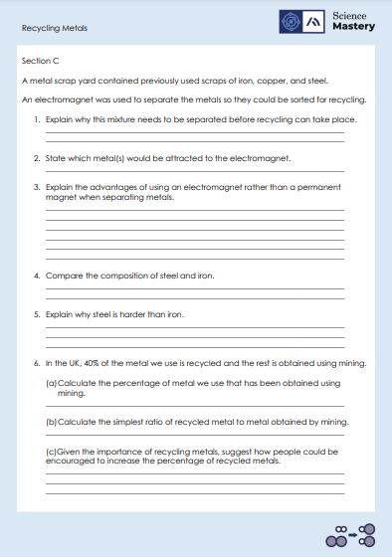
Activity

Slide 19
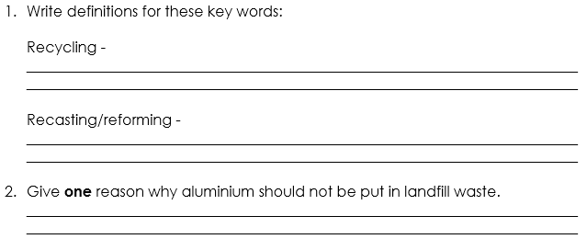
Answers – Section A
When a substance is collected and processed to form a usable material.
When molten, recycled metals are used to form something new.
Land fill sites are filling up.
Aluminium ore is non-renewable so could run out.

Slide 20
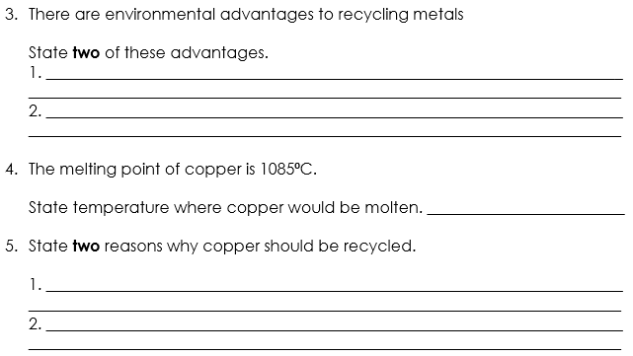
Answers – Section A
Less damage to the environment as no quarries or mines are required.
Valuable, non-renewable, raw materials are preserved.
Any temperature above 1085⁰C
Copper ore is running out so should be recycled/reused.​
To reduce the amount of copper entering landfill waste, which can be toxic

Slide 21
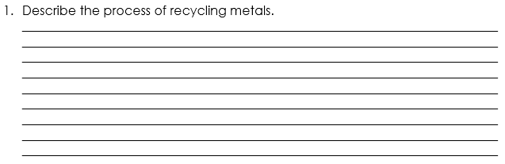
Answers – Section B
Scrap metal is collected and transported to a sorting centre.
Items are broken up, and sorted into different kinds of metals.
Other materials such as plastic are removed
The metals are melted down and are recast into new items.

Slide 22
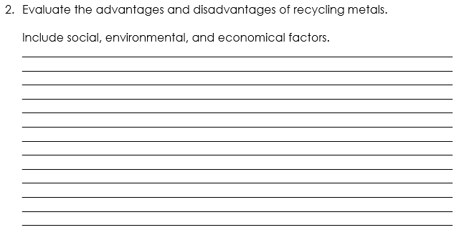
Answers – Section B
Category | Effect
Social (an effect to do with people)
Environmental (an effect to do with the environment)
Economic (an effect to do with money)
A social effect of recycling metals is that jobs are created to carry out process of recycling, which is an advantage for communities. However, a disadvantage is that people are expected to make more of an effort to clean, sort, and recycle their metal waste.
There are many environmental advantages to recycling metals, including preserving the dwindling supply of metal ores and reducing the amount of mining required. This means that there is less damage to habitats in the environment and less noise pollution.
The economic advantage of recycling metals is that it is cheaper than the cost of extracting new metals from ores. However a disadvantage is that there is still a cost to sort and recycle metals.
Overall, I think that we should recycle all metals because there are many social, environmental, and economical advantages.

Slide 23
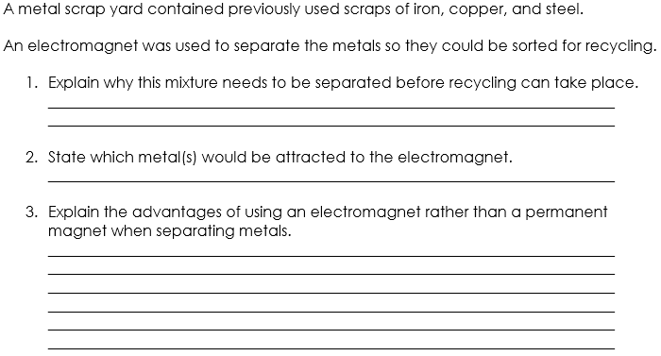
Answers – Section C
Separation of the mixture will allow pure metals to be extracted ready for melting and recasting.
Steel and iron
An electromagnet can be switched off and on, allowing control of the magnet, whereas a permanent magnet is always ‘on’.
This means that magnetic metals can be moved between different locations.
Additionally, the strength of am electromagnet can be controlled whereas it remains constant in a permanent magnet.

Slide 24
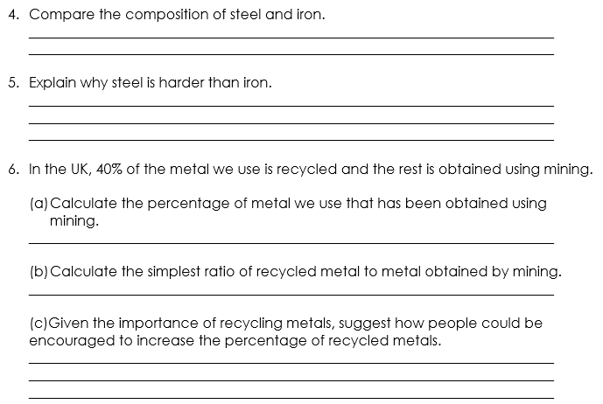
Answers – Section C
Iron is a pure metal whereas steel is an alloy containing both iron and carbon.
Alloys contain atoms of different sizes. This distorts the layers of atoms in a pure metal. This means that a greater force is required for the layers to slide over each other, creating a harder material.
100 – 40 = 60%
40:60 = 4:6 = 2:3
Provide information about the need to recycle and reward people to recycle (or fine people who don’t recycle).
Provide recycling bins and areas.

Slide 25
Answer the questions below.
Choose which describes a method used to recycle metals.
A. Reforming then melting
B. Recasting then reformed
C. Melting then recasting
✓
2. Steel cans should not be disposed of in landfill because…
A. the metal can be recycled instead
B. the iron can form iron ore
C. the landfill costs more than recycling
✓
3. Which of the following is a social advantage of recycling metals?
A. Recycling metals is less costly than extracting metals from ores
B. Recycling metals provides jobs for people
C. Recycling metals preserves valuable natural ores.
✓
Notes:
Q1. Answer: C
If students answer A or B, they are missing up the words used to describe the recycling of metals. To fix-it, ask students to define the melting and recasting of metals.
Q2. Answer: A
If students answer B or C, they cannot describe the advantage of recycling a metal. To fix-it, ask students to describe the advantages of recycling a metal with a list.
Q3. Answer: B
If students answer A or C, they are unable to differentiate between a social, environmental or economic advantage. To fix-it, gibe students a list of statements to classify as social, environmental or economic related. You may want to define these words for students beforehand.

Slide 26
Lesson C4.2.15
What was good about this lesson? | What can we do to improve this lesson?
Send us your feedback by clicking this link
or by emailing sciencemastery@arkonline.org
Thank you!

